Slide 1














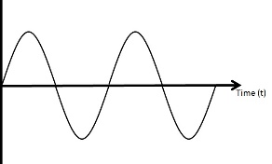
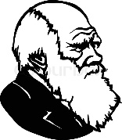

THE STANLEY HIGH SCHOOL
YEAR 11 SCIENCE LEARNING JOURNEY
GCSE Exams
Celebration time!
Results day
Half term
Next step
Prom
Leavers’ assembly
Easter
GCSE Exams
Revision
P13 Electromagnetism
Half term
Revision
B18 Biodiversity and ecosystems
Revision
Year 11 Mocks
P12 The electromagnetic spectrum
Christmas
C8 Rates and equilibrium
C12 Chemical analysis
Half term
B16 Adaptions, interdependence and competition
B17 Organising an ecosystem
Year 11 Mocks
September
C8 Rates and equilibrium
P11 Wave properties
B15 Genetics and evolution
ASPIRE, CHALLENGE, EXCEL at STANLEY HIGH SCHOOL

